Slide 1
Scenario: Burns
Emergency Care
CityWide ED Orientation, 2014

Slide 2
A….B….C….D

Slide 3
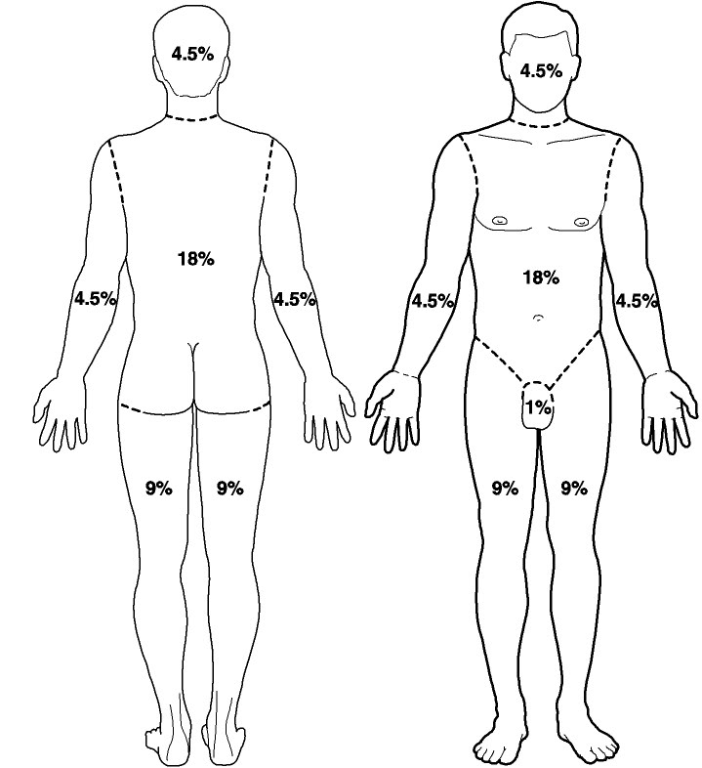
Rule of Nines

Slide 4
Fluid Resuscitation:
Formula for Burns
4 mL x body weight x % of TBSA burn
One half to be given within the first 8 hours
One half to be given in next 16 hours
Target urine output: 30-50 mL/hour
In children < 30 kg, target urine output is
1 mL/kg/hr.

